Slide 1

Spotify songs popularity visualization and analysis
Simrik Rijal (300340875)
Sisir Ghimire Chettri (300340871)

Slide 2
Overview
Spotify tracks dataset from Kaggle which was collected from Spotify’s Web API (2022)
25 MB file size (CSV)
114,000 rows of data
125 genres
Audio features like danceability, loudness and valence of each track
Dependent variable is Popularity (0-100), with 100 being most popular
Popularity based on artists, genres, tracks and music features

Slide 3
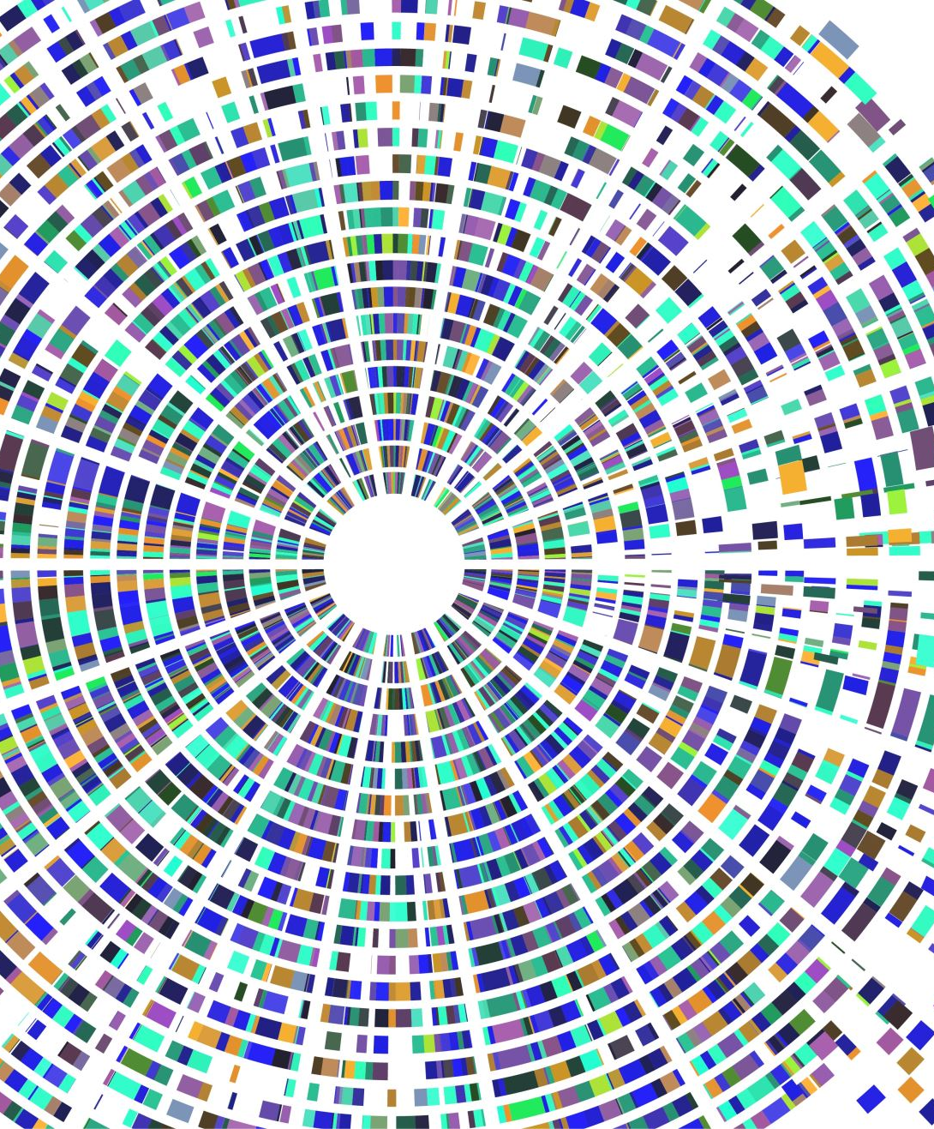
Exploratory Data Visualization (EDA)
Matplotlib, Seaborn and Word cloud libraries

Slide 4
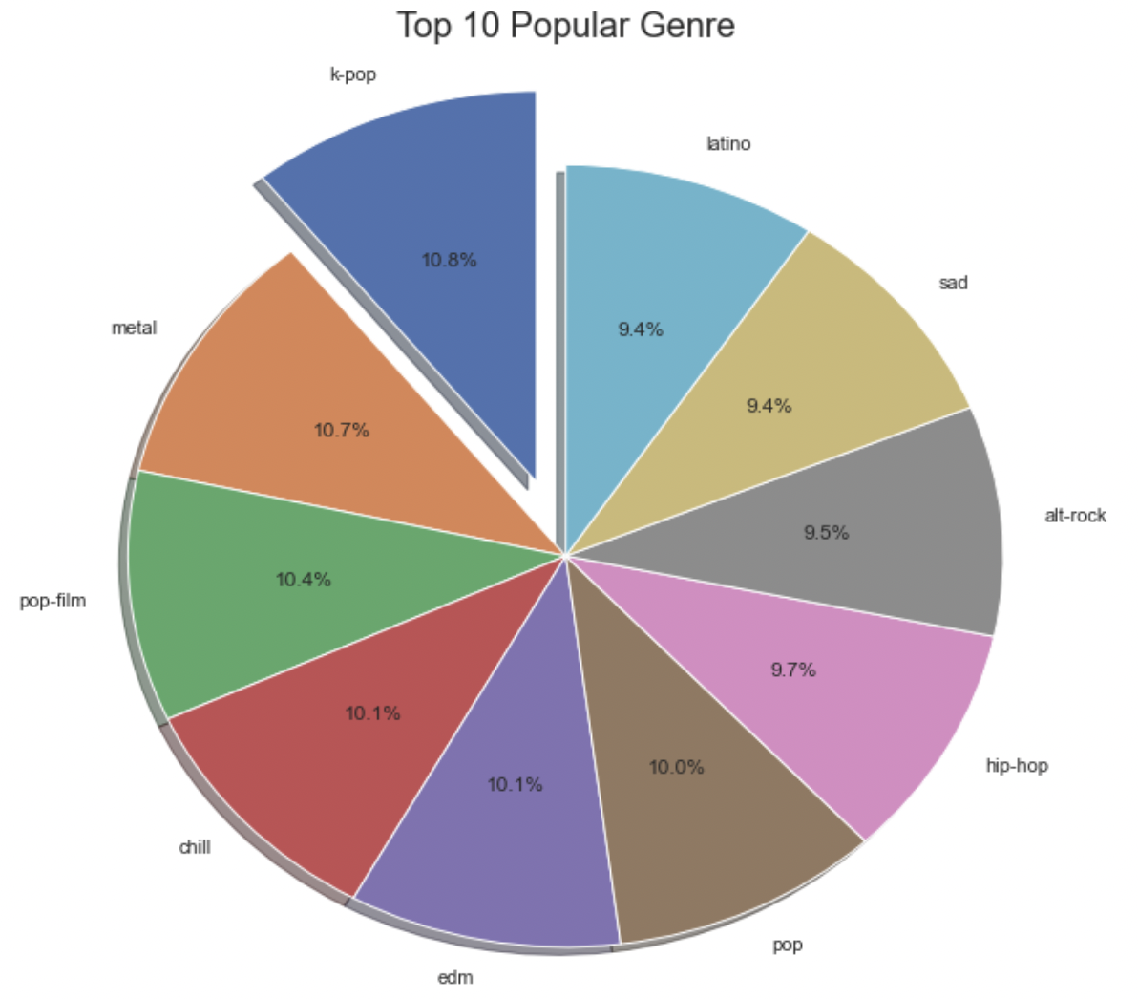
Top 10 popular genres
Genres | Popularity (0-100)
K-pop | 59.093750
Metal | 58.653595
Pop-film | 56.725552
Chill | 55.332790
Edm | 55.148760
Pop | 54.736508
Hip-hop | 53.142549
Alt-rock | 52.083333
Sad | 51.618333
Latino | 51.360248

Slide 5
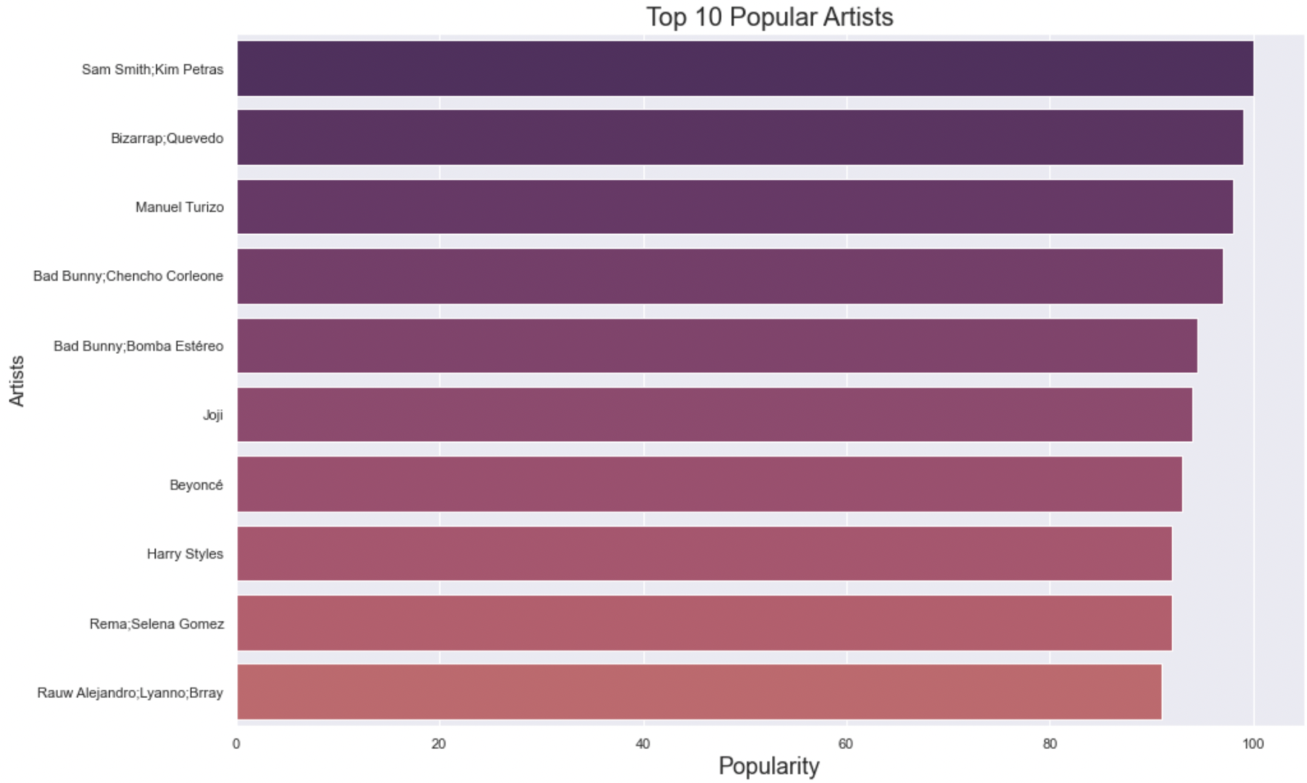
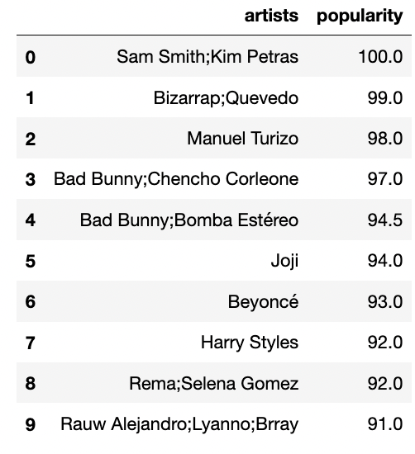
Top 10 popular artists

Slide 6
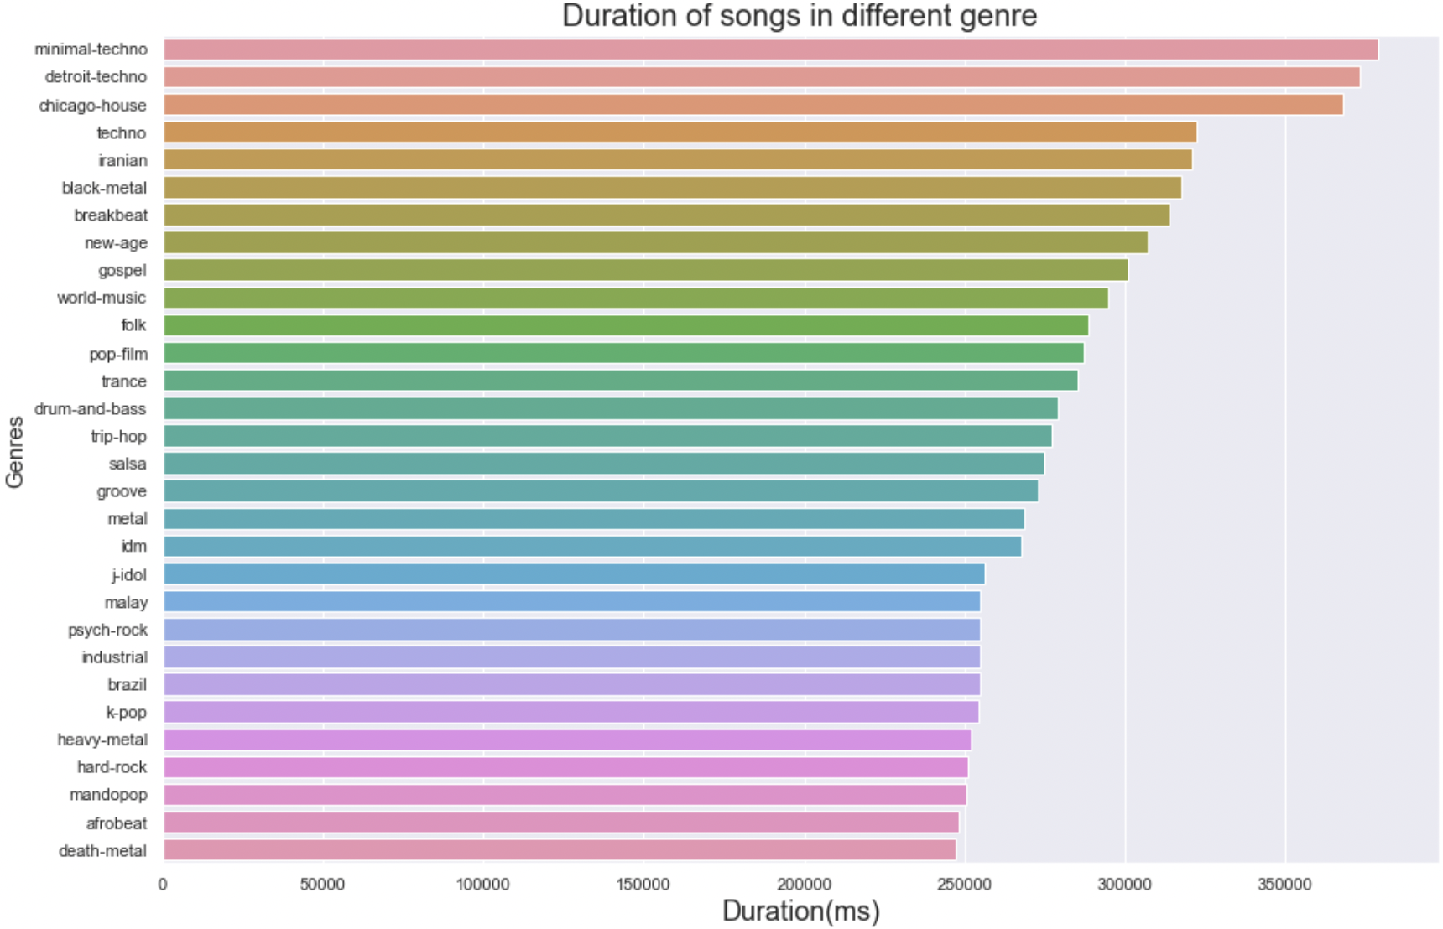
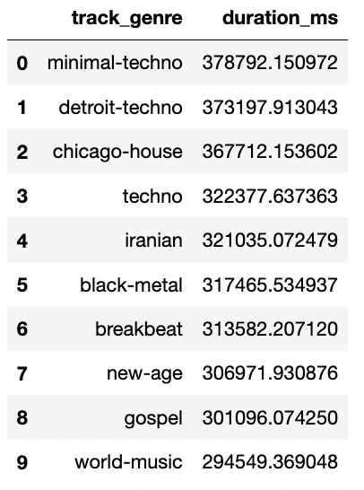
Duration of song in different genres

Slide 7
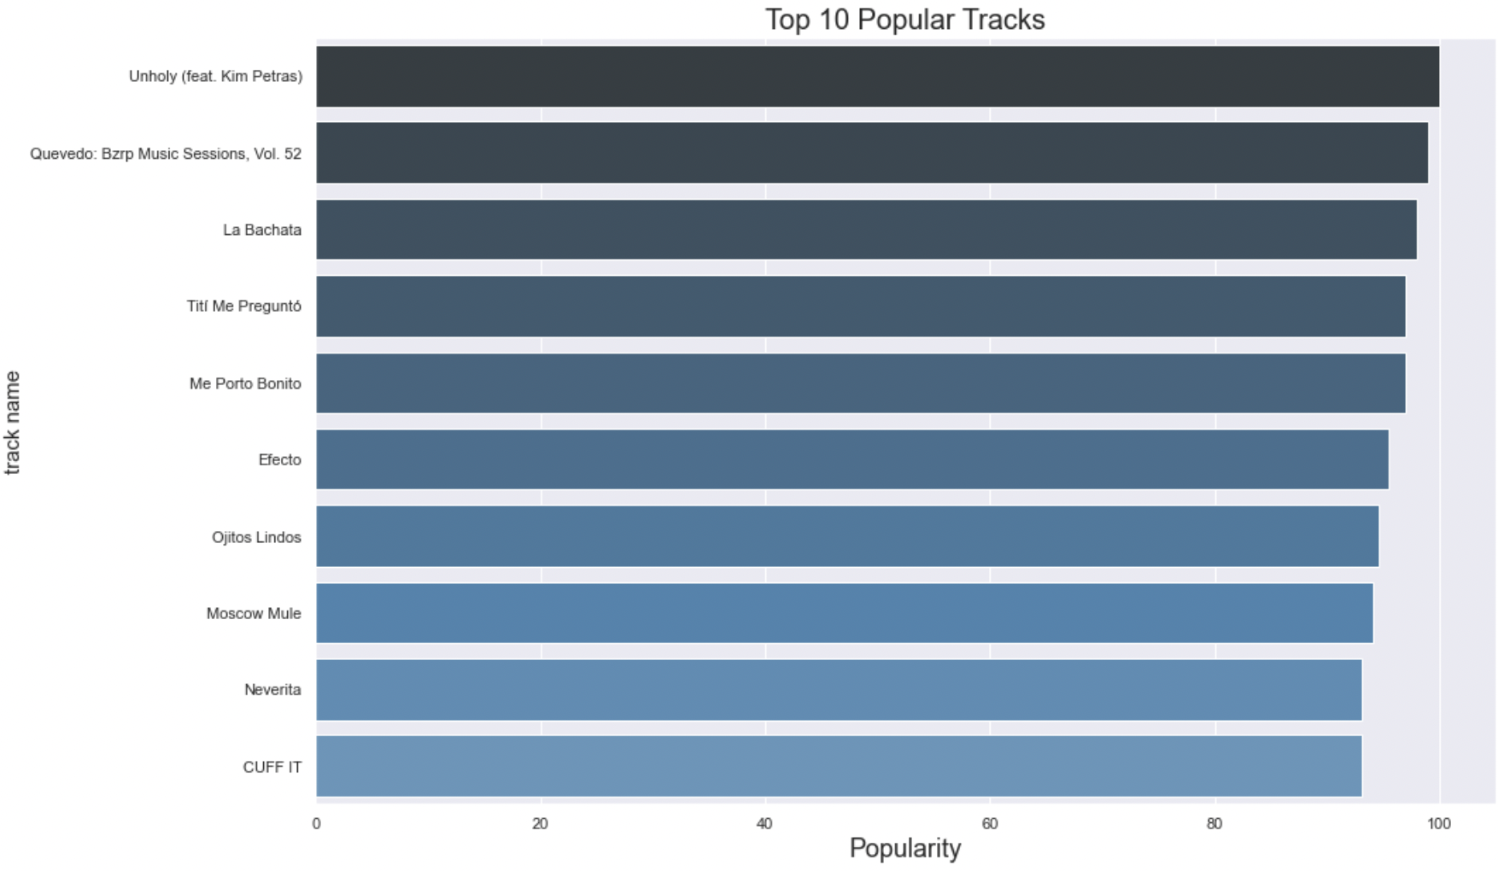
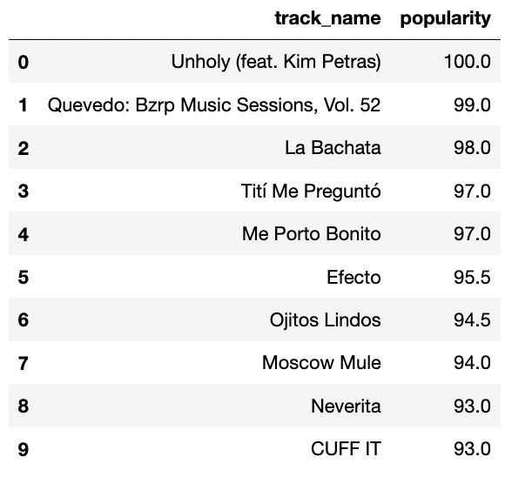
Top 10 popular tracks

Slide 8
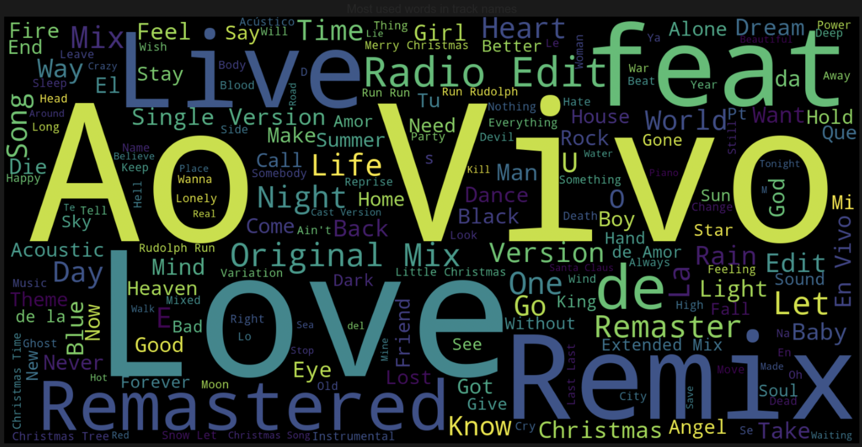
Word cloud of frequently used words in track names
Love
Live
Vivo
Ao
Remix
Remastered
Feat
Radio Edit

Slide 9
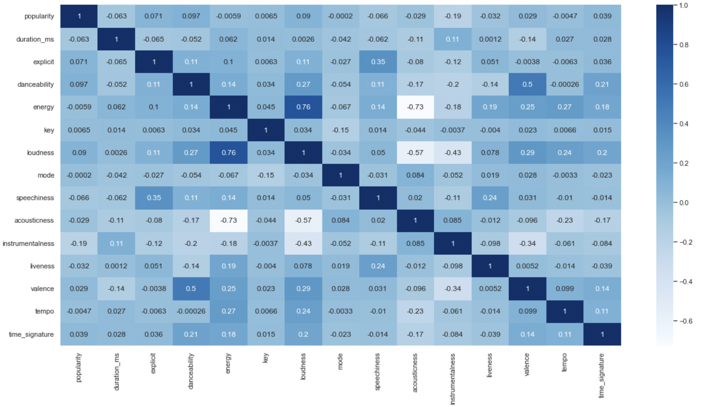
Correlation (heatmap)
Energy and loudness are positively correlated with each other because it makes sense for loud music to be energetic. Similarly, valence is also positively correlated with danceability because valence represents songs which are happy and cheerful.
Whereas, acousticness is negatively correlated with energy and loudness because acoustic songs are quiet and calm.

Slide 10
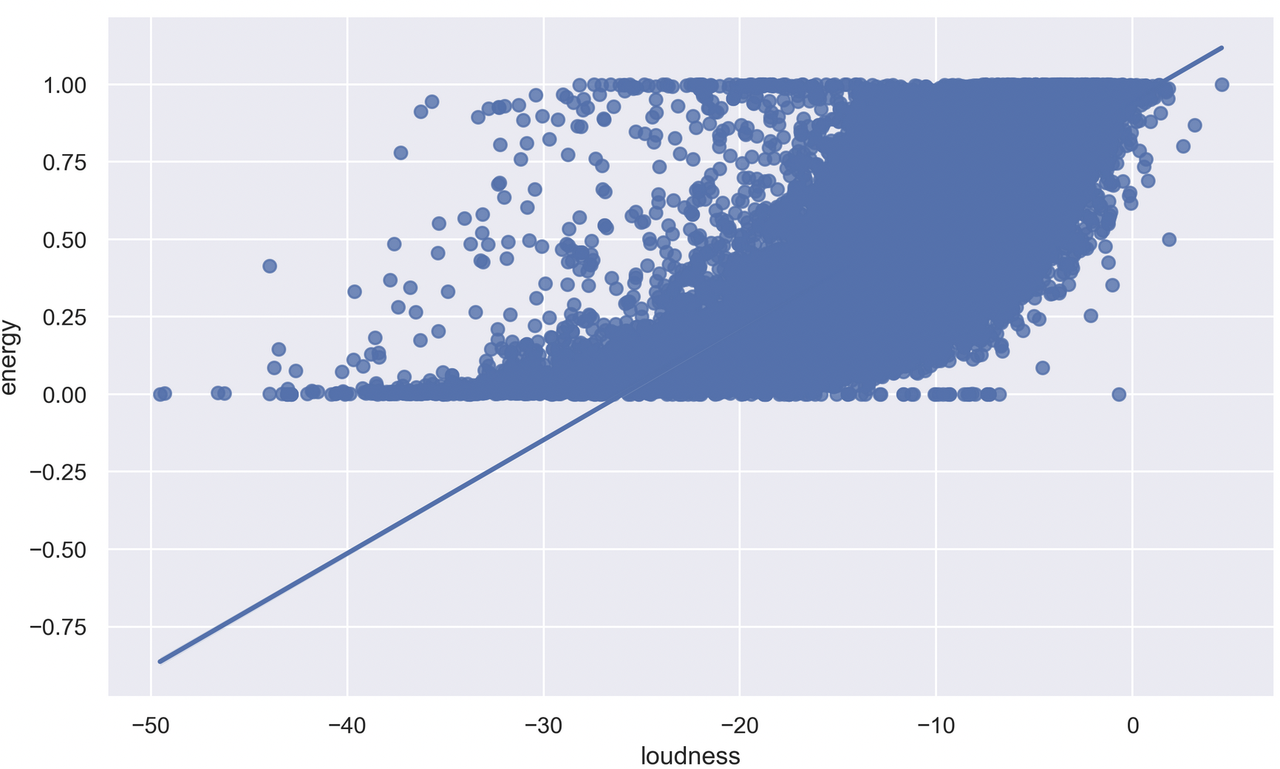
Correlation: Loudness vs energy
Loudness and energy correlated with each other at almost 45 degree which suggests that there is strong relation between a song being loud and energetic.

Slide 11
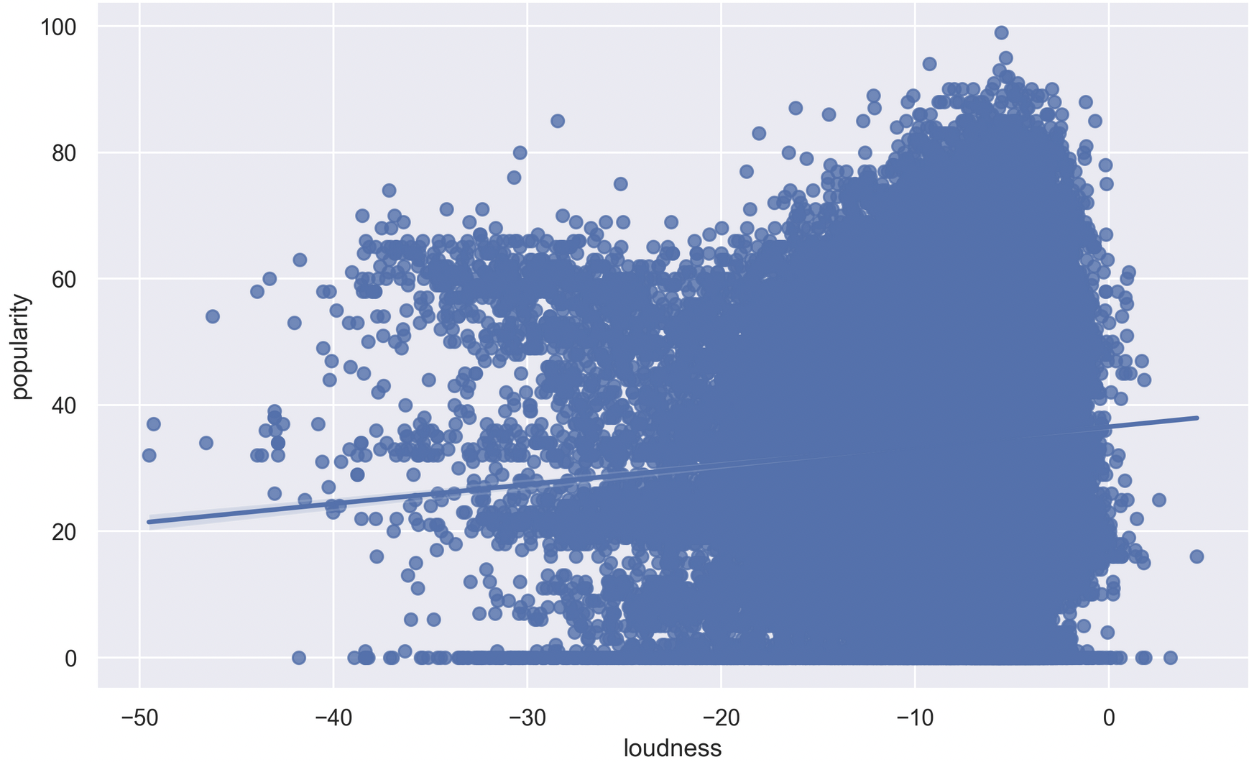
Correlation: Loudness vs popularity
With over 100,000 songs we can infer that there’s slight correlation between the music being and loud and popular.
Most of the loud music are popular compared to the ones that are less loud.

Slide 12
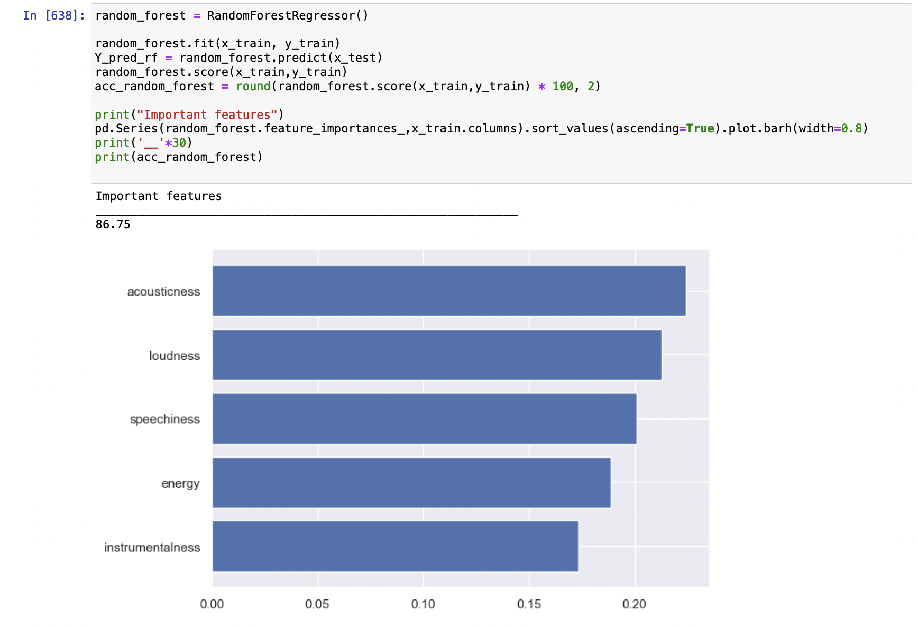
Feature selection
We tried different models and came up with the best score of important features from RandomForestRegressor.

Slide 13
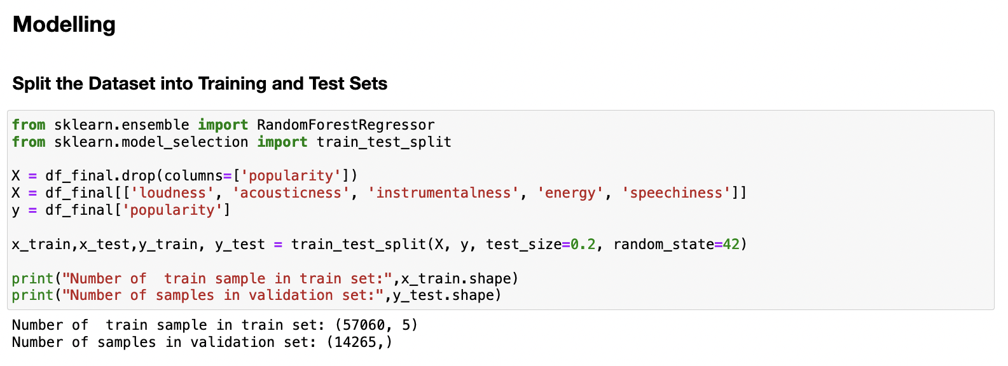
Train and test sets

Slide 14
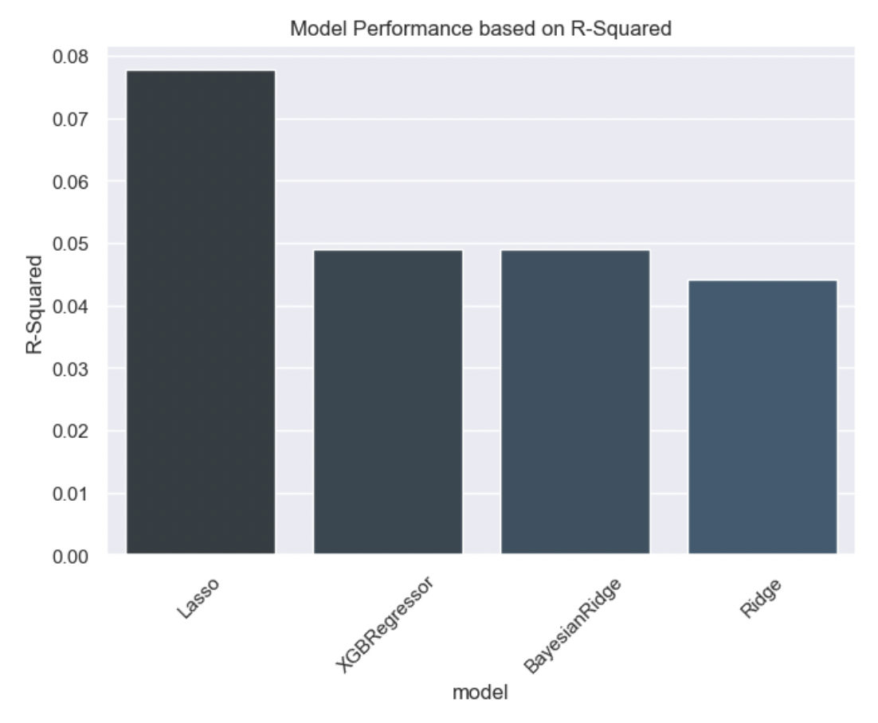
Model outcomes
We can see that even the well performing model, Lasso has relatively very low R-squared which suggests that even though some of the data points are correlated with popularity but can be problematic to precisely predict the value of popularity based on these correlated data points and from above R2 squared.

Slide 15
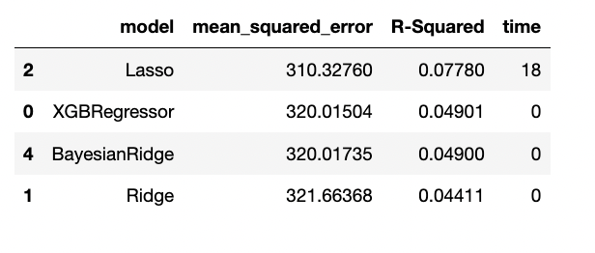
R square from different models

Slide 16
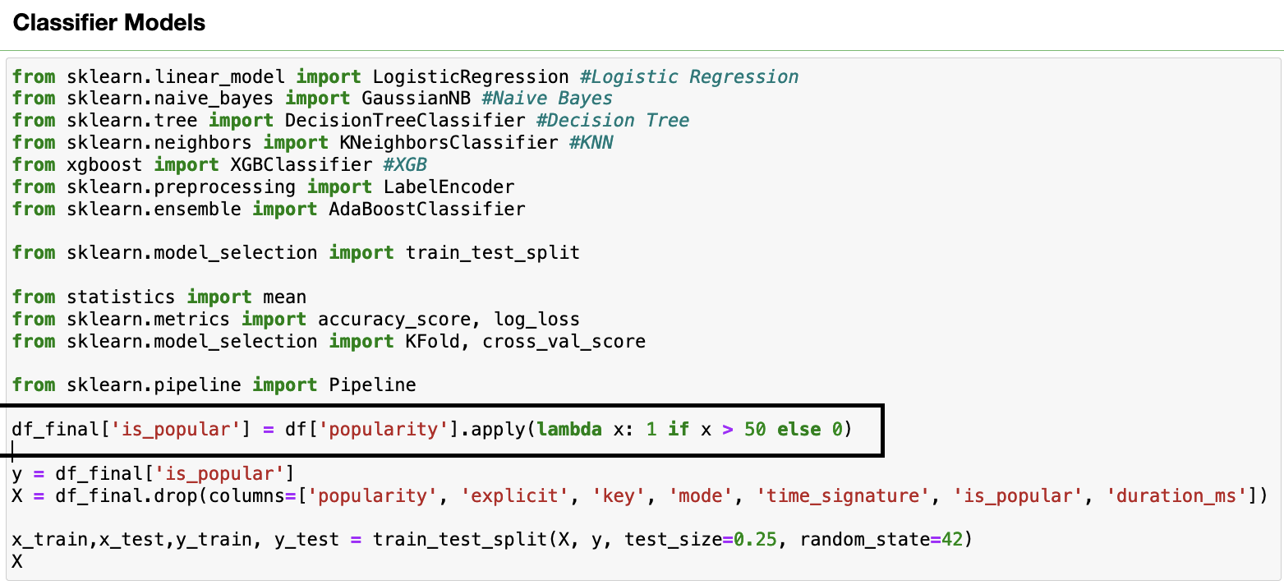
Classifier modeling

Slide 17
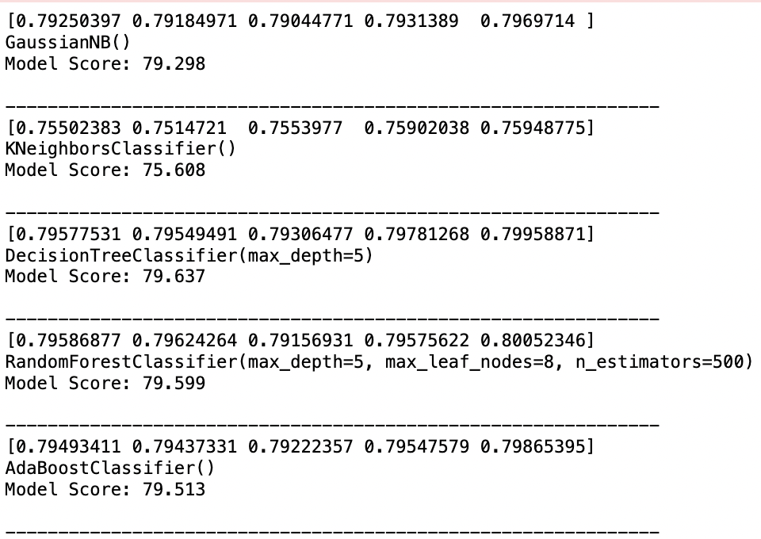
Model score from different classifiers

Slide 18
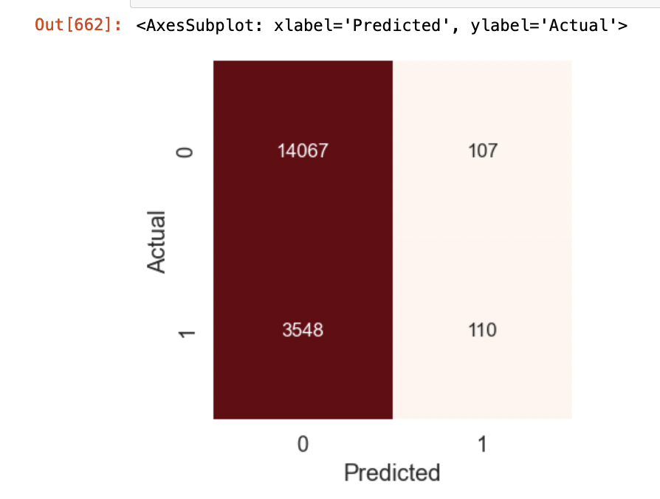
Confusion matrix
True negative and false negative is quite high but we got true negative on the higher side.
True positive and false positive although there are less occurrences, confusion matrix is showing the false negative on the higher side.

Slide 19
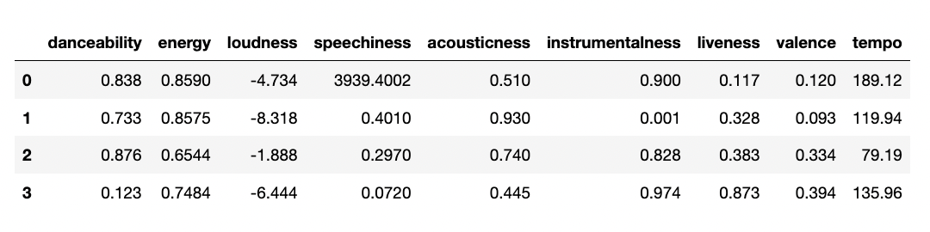
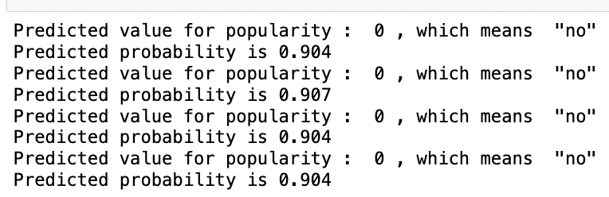
Out of sample prediction
From the analysis, it seems that for a song to be popular it is quite hard and not every feature of song can be easily integrated to make a song popular.

Slide 20
limitations
This dataset did not have date variable which restricted us from making analysis based on time-series, about how music is evolving with time.
Availability of many features made it quite difficult to choose right set of features.
Since this dataset has a lot of rows it was at times very time consuming to run different models.

Slide 21
Learning, summary and prediction
The popularity of a song is influenced by the danceability, loudness and valence.
The factors that determine the song’s genre are danceability, energy and valence.
K-pop music is most popular nowadays.
Minimal-techno genre has the longest track duration.
Sam Smith’s (ft. Kim Petras ) Unholy is the most popular track.
High energy dance songs and songs with duration of approximately 3 minutes are more likely to become popular.
Although our models were not with good scores and highly significant in terms of different metrics, but we learned that with every dataset comes a challenge to build better models and improve scores by applying different tuning to models.

Slide 22
Thank you

